Slide 1
Iteration 04 Sequence Diagram

Slide 2
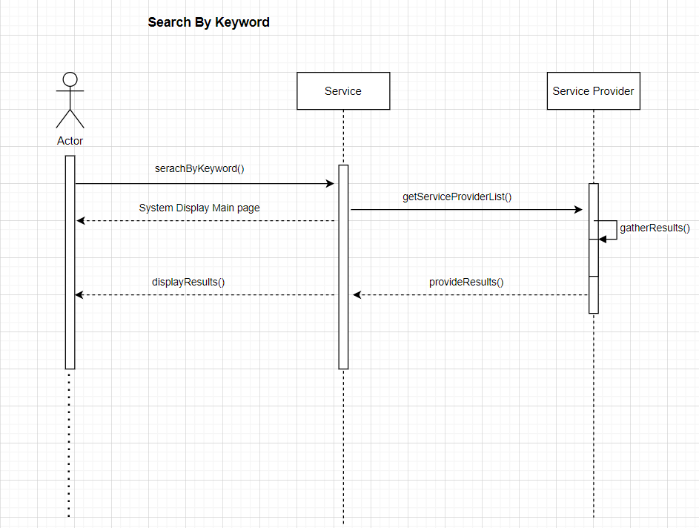

Slide 3
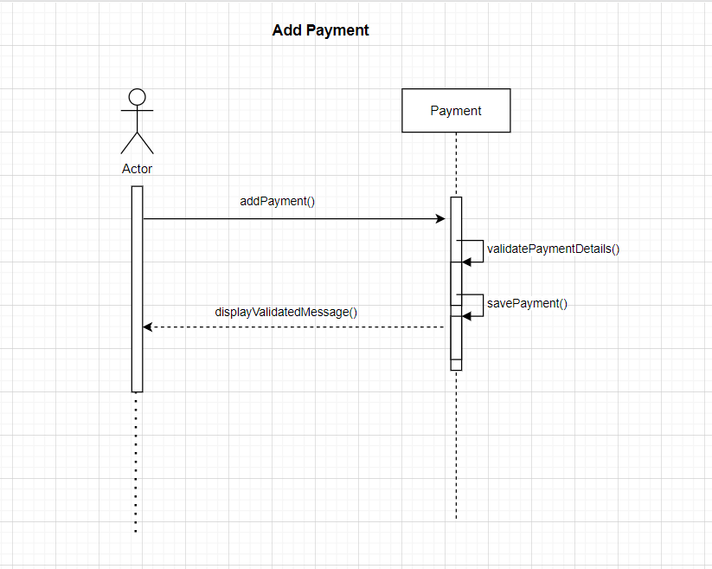

Slide 4
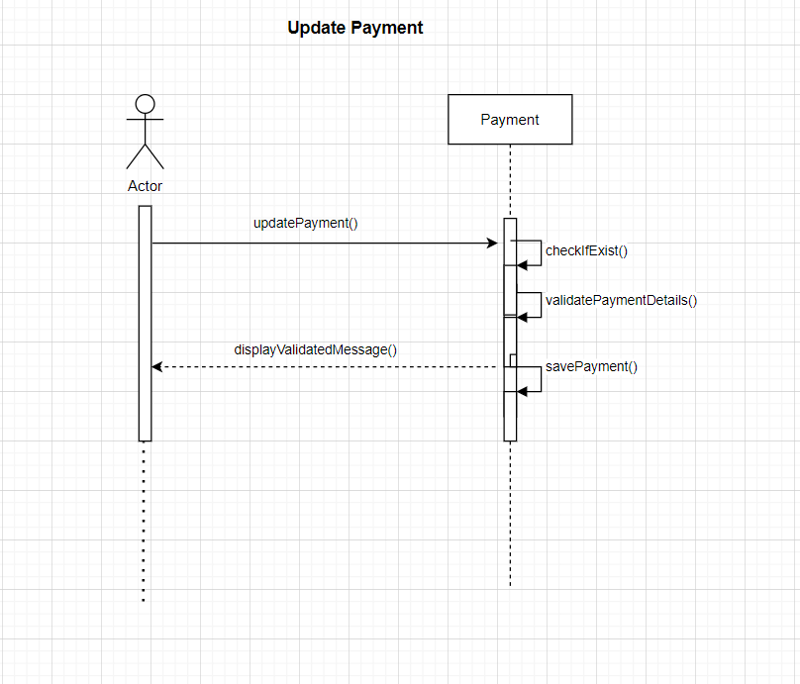

Slide 5
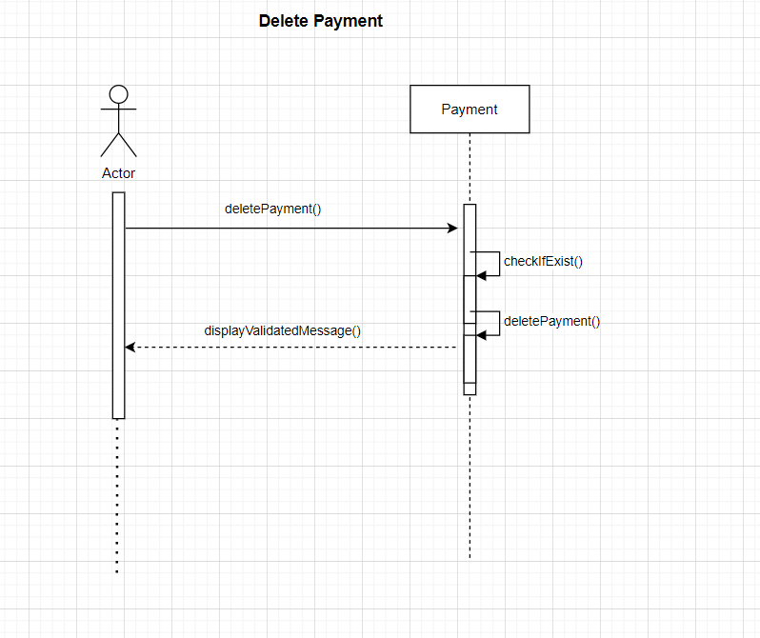

Slide 6
Iteration 4 Class Diagram

Slide 7
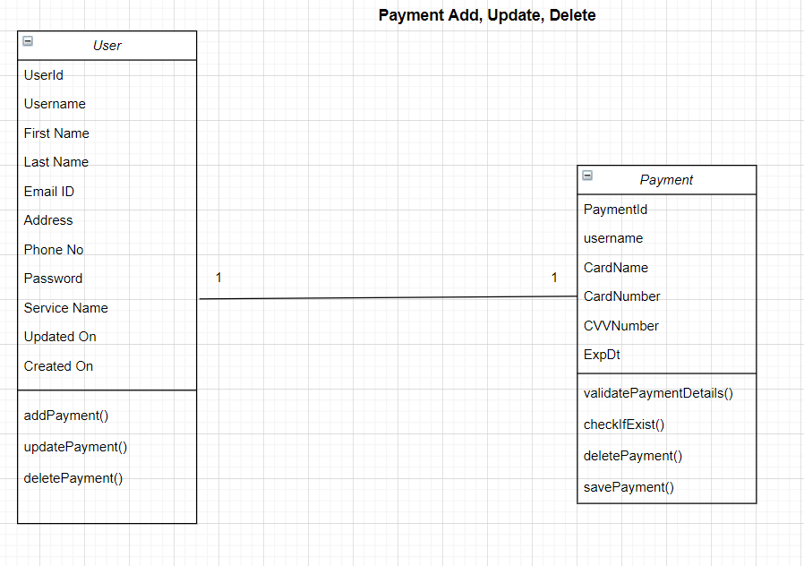

Slide 8
